Slide 1

Prediction of customer churn in telecom industry

Slide 2
Abstract
The market is very dynamic and highly competitive
It is very easy for customer to switch from one service provider to another for a better price rates or service quality.
Telecommunication companies suffer a loss of 20-40% of their customers every year
Customers today go through complex decisions making process before subscribing to any one of numerous telcom service options
Companies in the telecommunication industry realize that customers are the most important assest for them

Slide 3
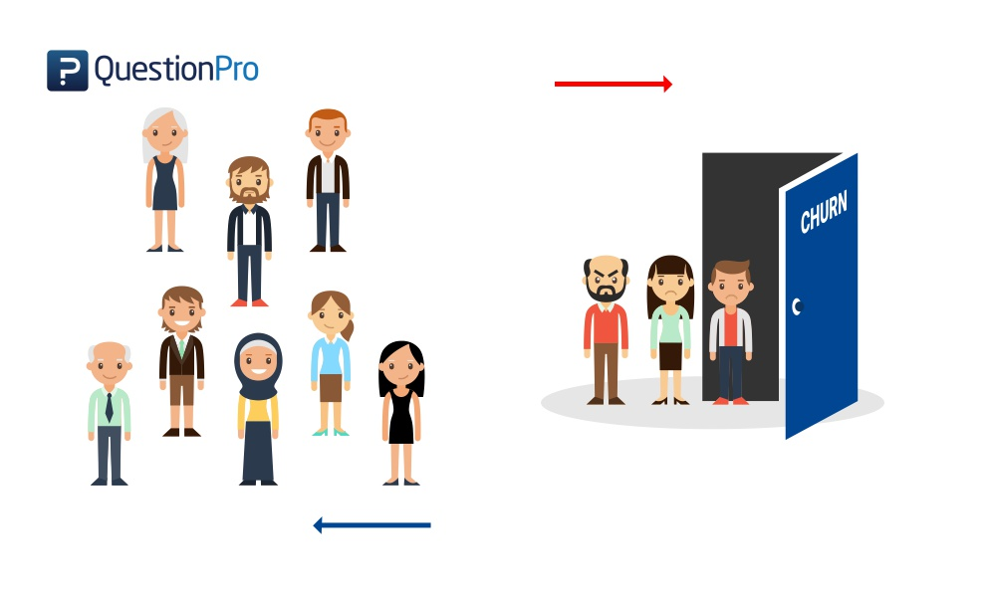
What is customer churn
In business “customer churn” is a term commonly refers to customers who stop using services or terminate their contract and subscription with a company to switch to another competitor
Customer churn has many reasons and factors. Such factors include quality and cost of services

Slide 4
Objective
The main objective of our project is to develop a churn prediction model which predicts customers who are likely to churn using machine learning techniques
The customers are churned based on the attributes like online security, phone services, tenure, online backup

Slide 5
Existing System
Many approaches were applied to predict churn in telecom companies. Most of these approaches have used machine learning and data mining. The majority of related work focused on applying only one method of data mining to extract knowledge, and the others focused on comparing several strategies to predict churn.

Slide 6
Limitations
We will be able to predict the customer churn of a telcom company. But beyond that we can not able to calculate the churn management
Churn management specifies how to keep current customers as long as the company is alive in the market
The revenue for the company comes from the creation and maintenance of the customer

Slide 7
Proposed Systems
In this proposed system we are able to identify the customers who are at the high probabilities of churn
By prediction of customer churn in telcom we are able to take suitable measures accordingly to reduce the churn
Specific marketing campaigns could be designed to target the mostly risky customer segments
By finding the probability of churn customers it is easy to make required changes in the features of the company

Slide 8
Start the process
Detecting a churn by observation is almost impossible
Traditional surveys based on running questionnaires or interviews suffer from a high cost, limited access to customer population and data self-reporting
Telecom companies realize that their existing customer database is the key
Service providers started to invest more in data mining techniques or machine learning techniques that can aid in having an efficient churn prediction models

Slide 9
Architecture
Google Colabs
OS and Applications
Kernal
Training
Data set
Logistic Regression
Test Dataset
Random Forest
SVM(Support Vector Machine)
Churn List

Slide 10
List Of Modules
Data manipulation : All the provided data in the dataset is manipulated accordingly
Data Analysis : The features provided in the dataset are analyzed and the churn rate is predicted
Visualization : This is done to the data present in each feature on which the customer churn rate depends
Prediction: This is done by using several machine learning algorithms like logistic regression which is under regression and decision tree under classification and svm(Support Vector Machine)

Slide 11
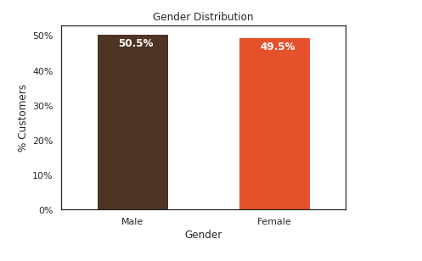
Customer Demographics
Gender classification-
This visualization is used
for classification of males and females.
It becomes easy for calculating
the churn rate by classifying the gender
This helps to know which
group of people are comming
out of the organization

Slide 12
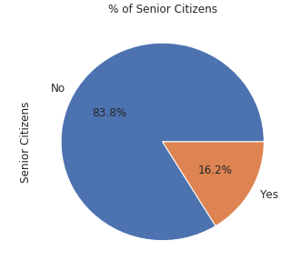
Customer Demographics
The visualization of senior citizens is done through Pie-chart visualization.
This will help in calculation of churn rate .
By classifying the senior citizens we can calculate the where the churn rate is high and we can offer the discounts to those group of people

Slide 13
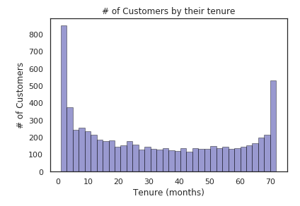
Customer relationship variable
The visualization of tenure variable is done by distplot which helps in calculating churn rate
It is better for a company to maintain their old customers than to attract new customers

Slide 14
Conclusion
By using this project we will be able to calculate the churn rate among the customers of telcom company
This is based on the features of the customer like Senior Citizen, tenure, Monthly Charges, Total Charges
By predicting the churn rate we can make appropriate changes in the plans provided by the company and provide offers for the customers

Slide 15
References
Telcom dataset from kaggle(https://www.kaggle.com/puja19/telcom-customer-churn)

Slide 16
Team Mates
T.Khyathi
S.Sindhuja
M.Pranavi

